Slide 1
how old would you be if you didn’t know how old you were?

Slide 2
Esri’s Young Professionals
Lighting Panel
Courtney Claessens
John Fry
Sarah Schwoppe
John Dombzalski
Moderated by Jon Bowen

Slide 3
this is mean to be informal so drum up some good questions about speakers, esri, or GIS as a whole and we’ll address them afterwards.
first off

Slide 4
don’t be intimidated by the giant.

Slide 5
don’t be intimidated by the giant.
enterprise

Slide 6
don’t be intimidated by the giant.
corporate

Slide 7
don’t be intimidated by the giant.
non-open source

Slide 8
don’t be intimidated by the giant.
global leader

Slide 9
don’t be intimidated by the giant.
product engineer

Slide 10
don’t be intimidated by the giant.
solutions engineer

Slide 11
don’t be intimidated by the giant.
product manager

Slide 12
don’t be intimidated by the giant.
because it’s actually pretty awesome

Slide 13

don’t be intimidated by the giant.
because it’s actually pretty awesome

Slide 14
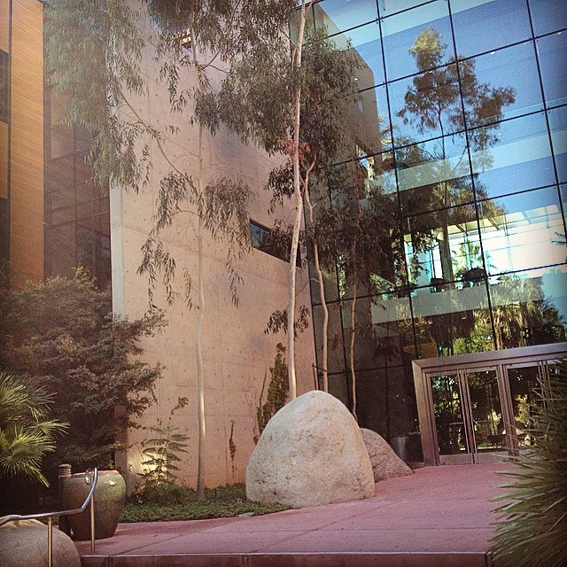

don’t be intimidated by the giant.
because it’s actually pretty awesome

Slide 15
creative
making new products or current products better

Slide 16
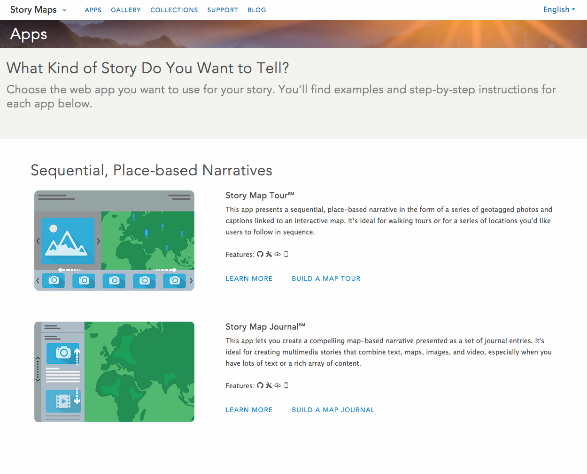
creative
making new products or current products better

Slide 17













global solutions to global problems
implementing effective change to multiple cities and multiple policies

Slide 18
established user community
opportunities over barriers

Slide 19


Slide 20

Advance your work by using ArcGIS Solution Templates
Federal GIS Conference
February 9–10, 2015 | Washington, DC
John Fry
Solution Engineer, Esri
jfry@esri.com
Notes:
Take time later in the afternoon to get an in-depth look at how Esri technology can strengthen and advance your work. From Open Source to Open Data, we’ll cover the issues that matter most to you and share some of the amazing work of Esri’s own young professionals. - See more at: http://www.esri.com/events/federal/agenda/young-professionals#sthash.czsbGeop.dpuf
Outline:
New Project – Where to Start?
Study Manuals/See What’s out there
Begin project
Then find solution pages

Slide 21
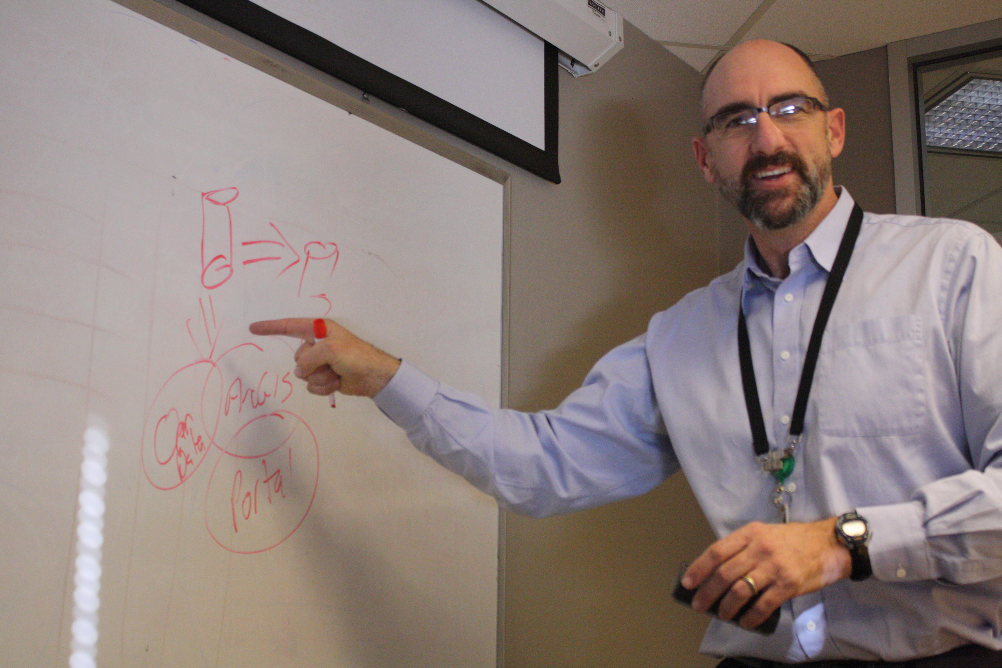
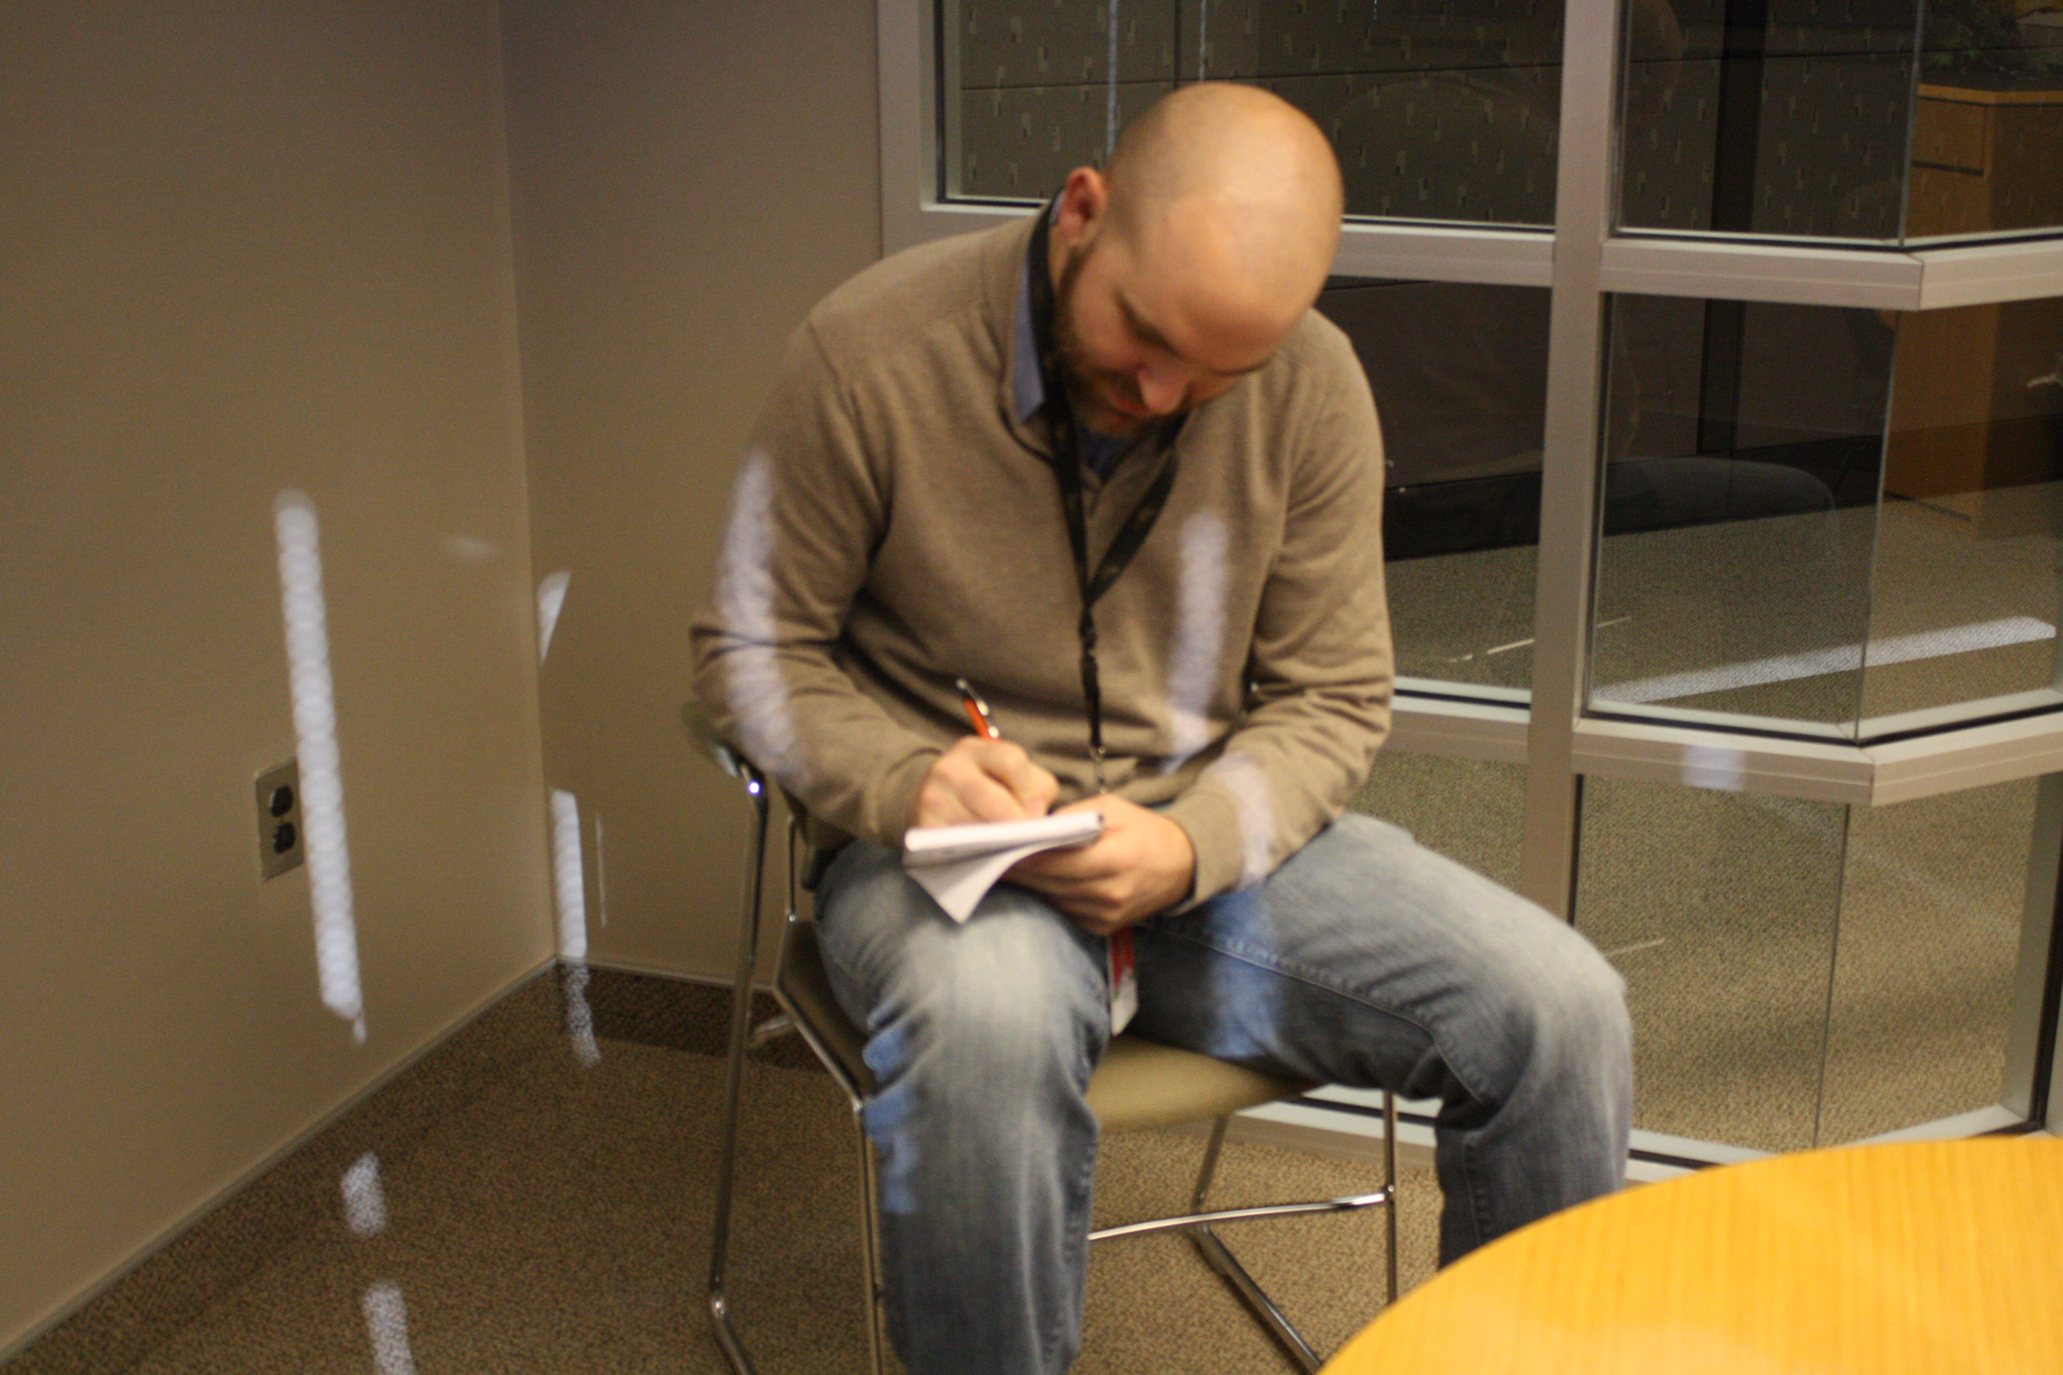
Say your boss calls you into his office….
“Hey, GIS person, I need a map made. Can you do
something where it shows the routes of each soldier’s
home to his base??? “
“Yes, that’s something I can do”
Notes:
-Add photos here of boss and myself at a desk

Slide 22
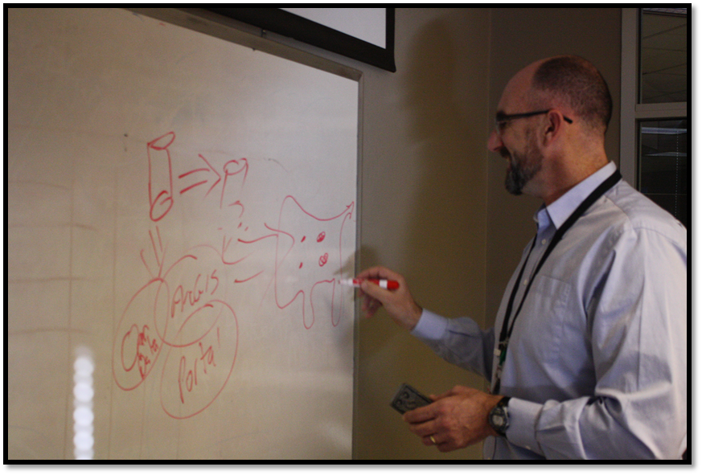

“So there’s something like 30,000 addresses
and 300 or so bases. Does that make a big
difference in your analysis?“
“Hmm, that does make it challenging, but
could get it done”
Notes:
-Add photos here of boss and myself at a desk

Slide 23
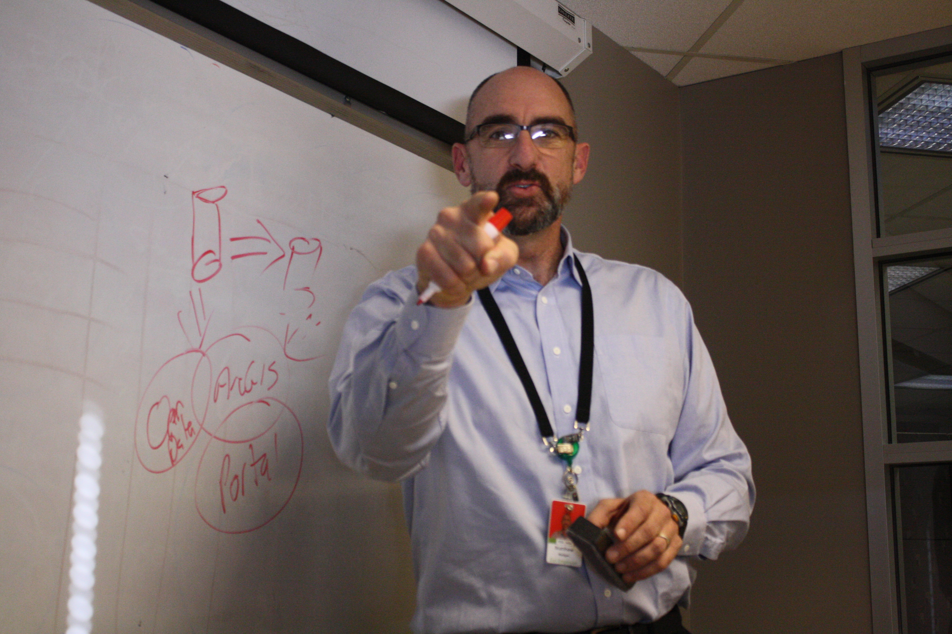
“Well, I need you to do this and fast! Get back
to me with updates”

Slide 24
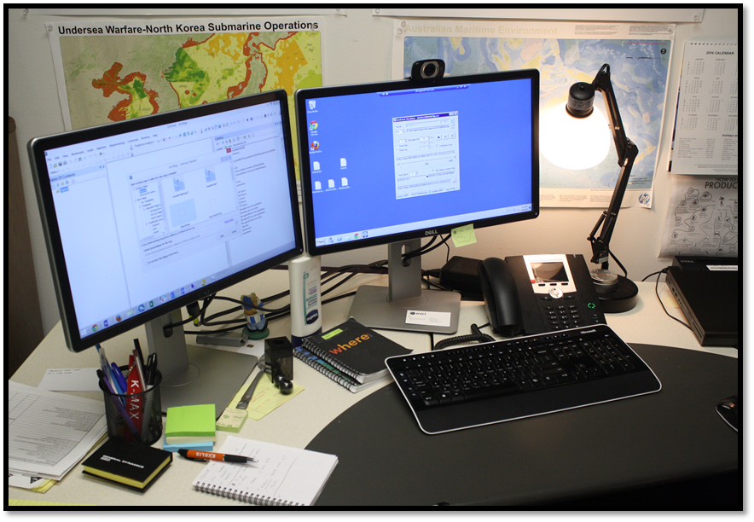
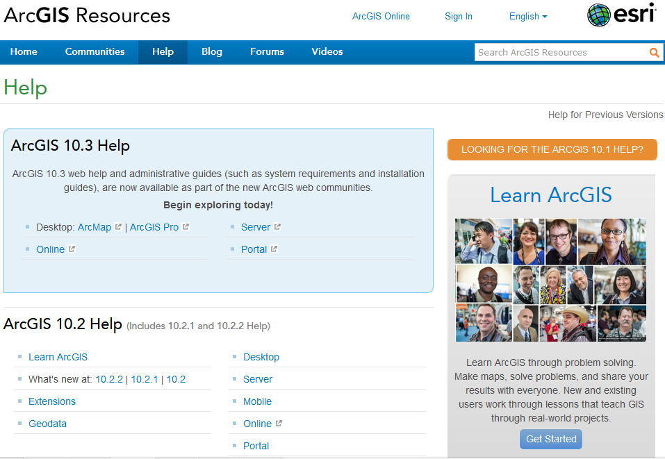
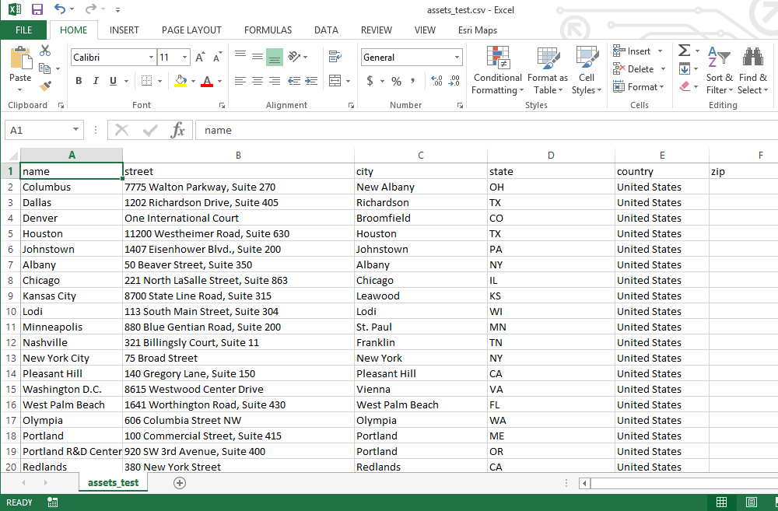
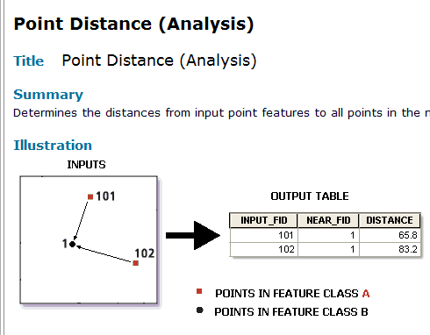
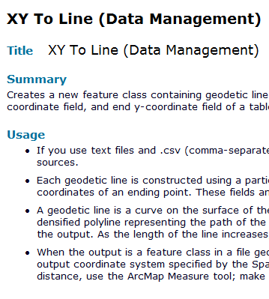
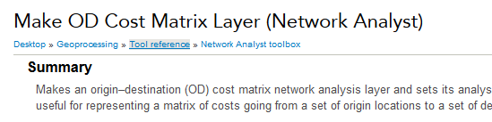
So you go to your desk…
Notes:
-Picture of me at desk
-Picture reading a manual
-Searching the internet

Slide 25
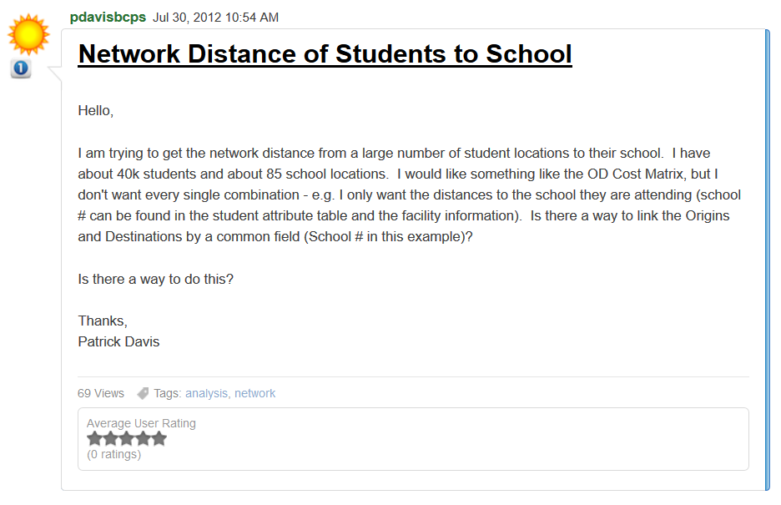
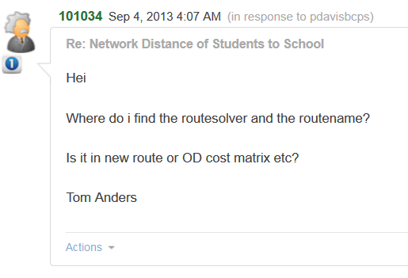
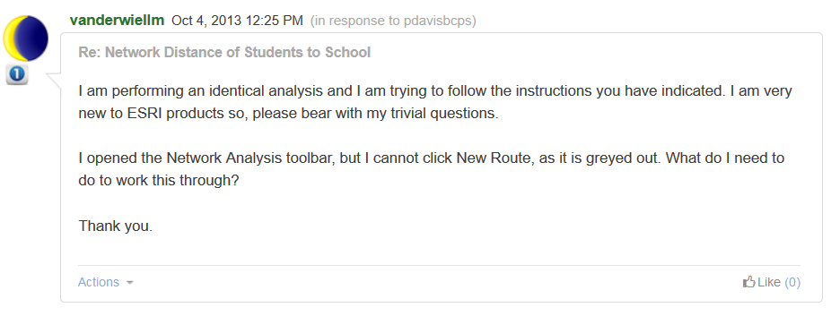
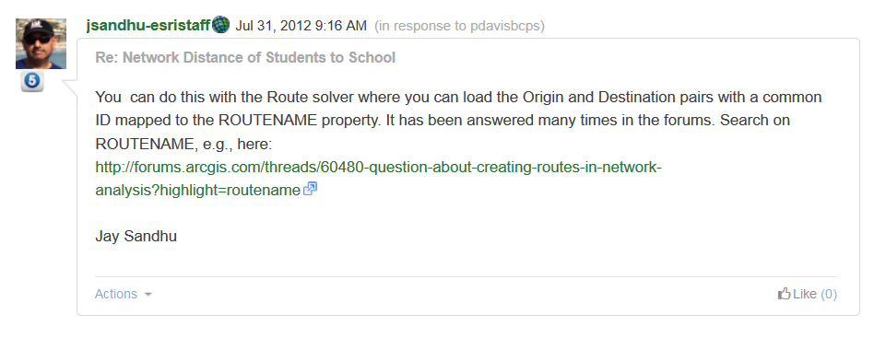
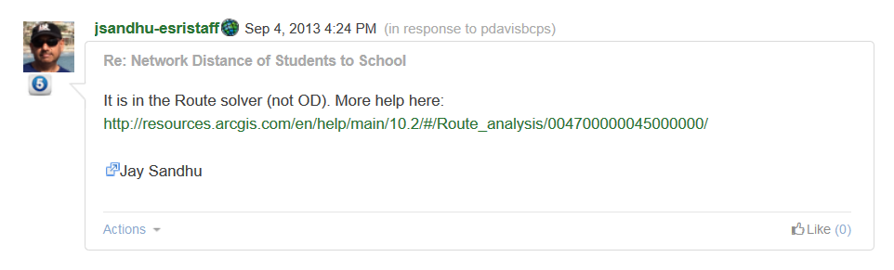
https://geonet.esri.com/message/57579
Notes:
Even though a blog about the problem I am trying to solve, there is no template or foundational data.

Slide 26
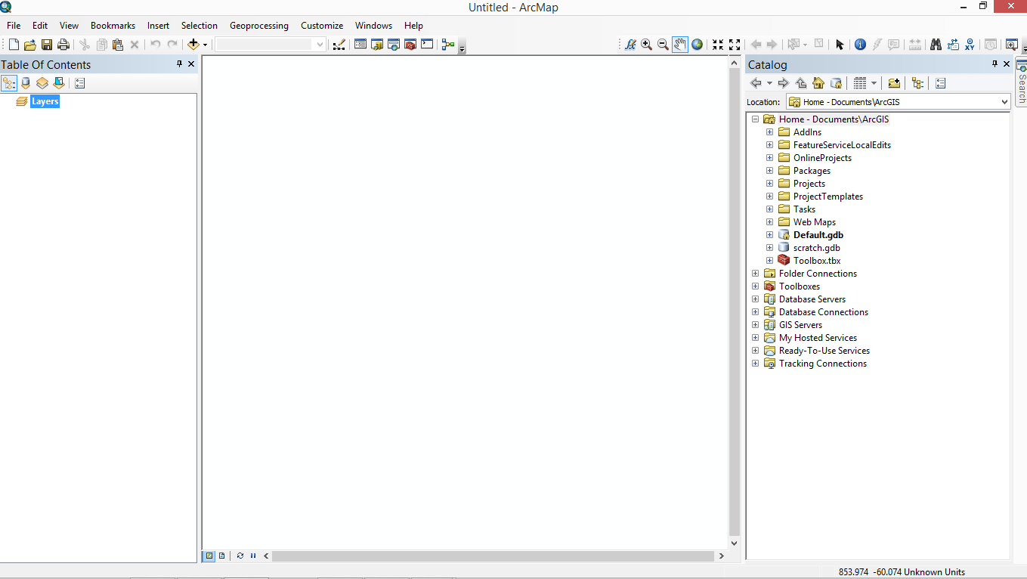
Notes:
ArcMap open to a blank page – hard to start a project with no guidelines…. Need templates

Slide 27
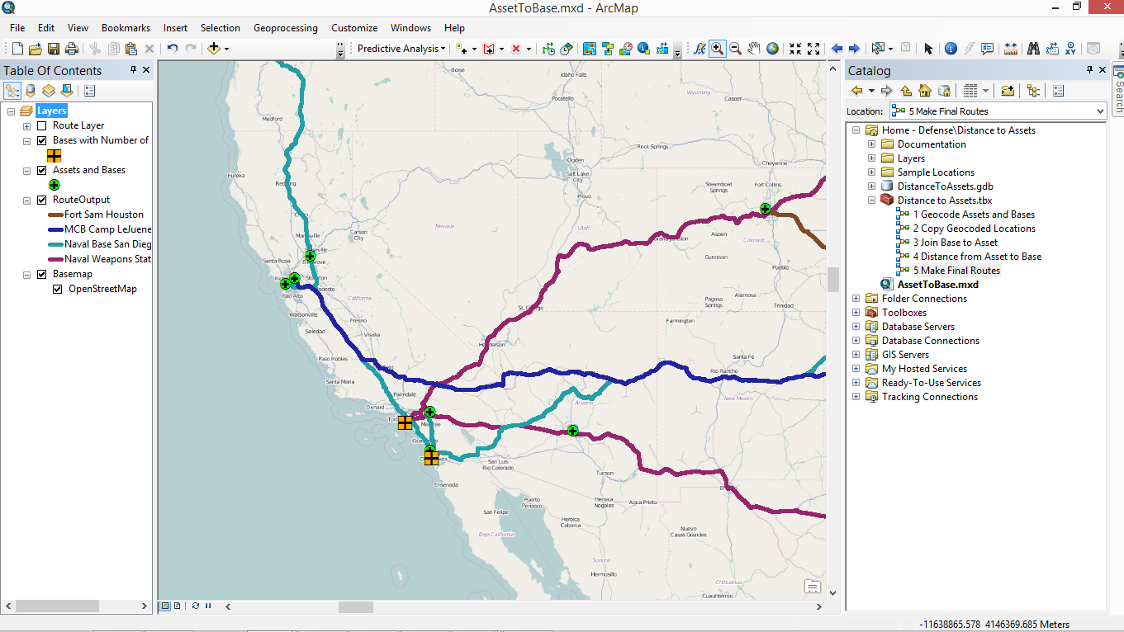
Notes:
Wouldn’t it be better to have an example to follow? That’s what templates are.

Slide 28
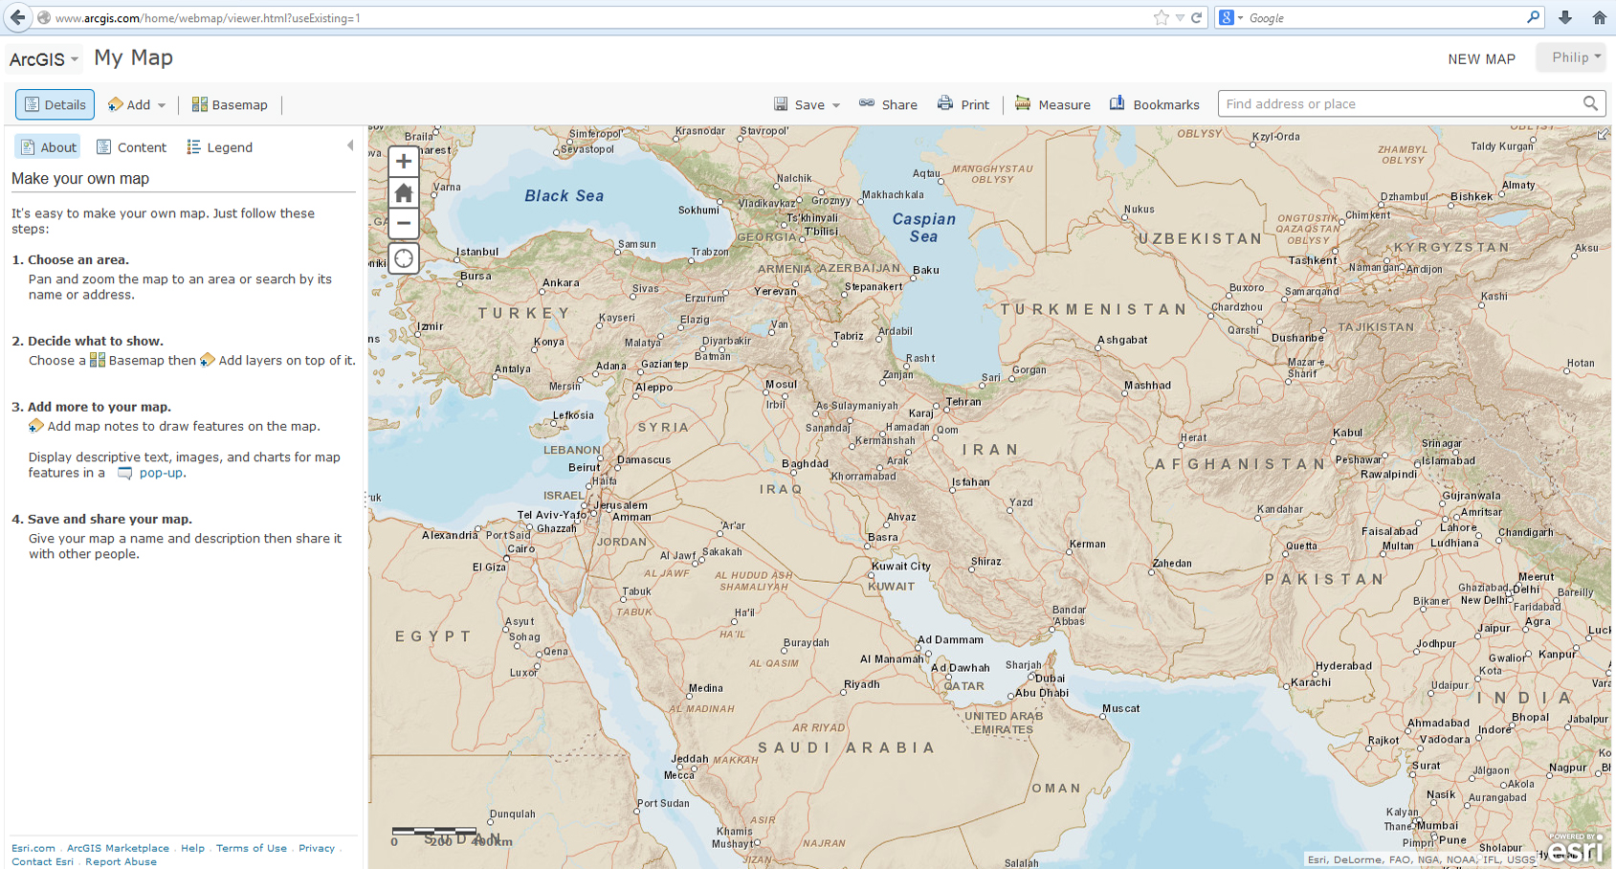
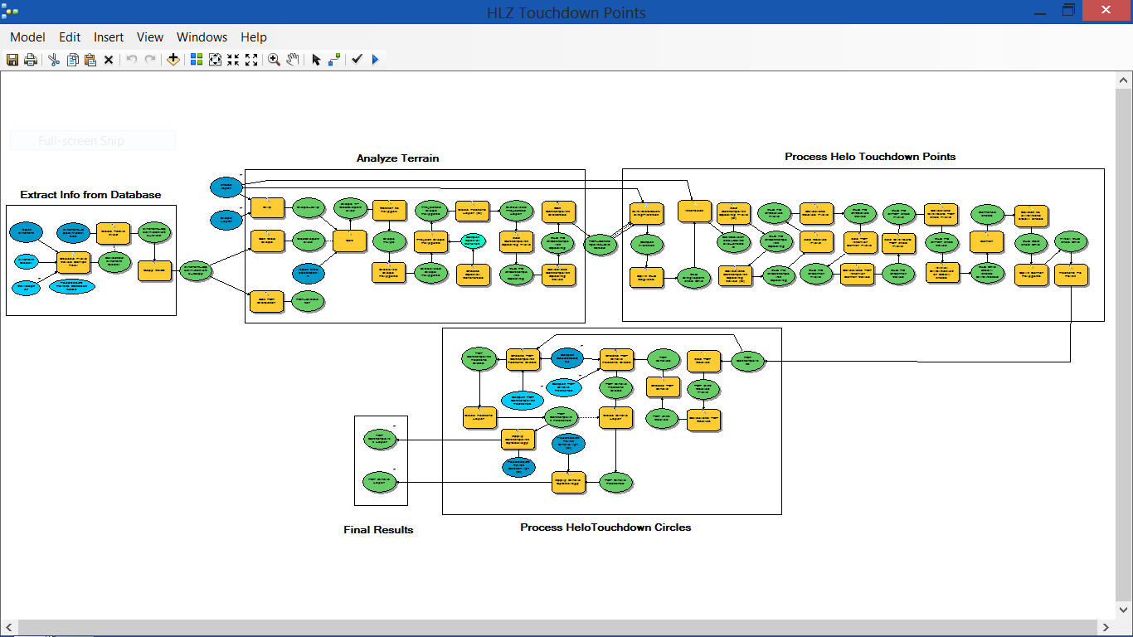
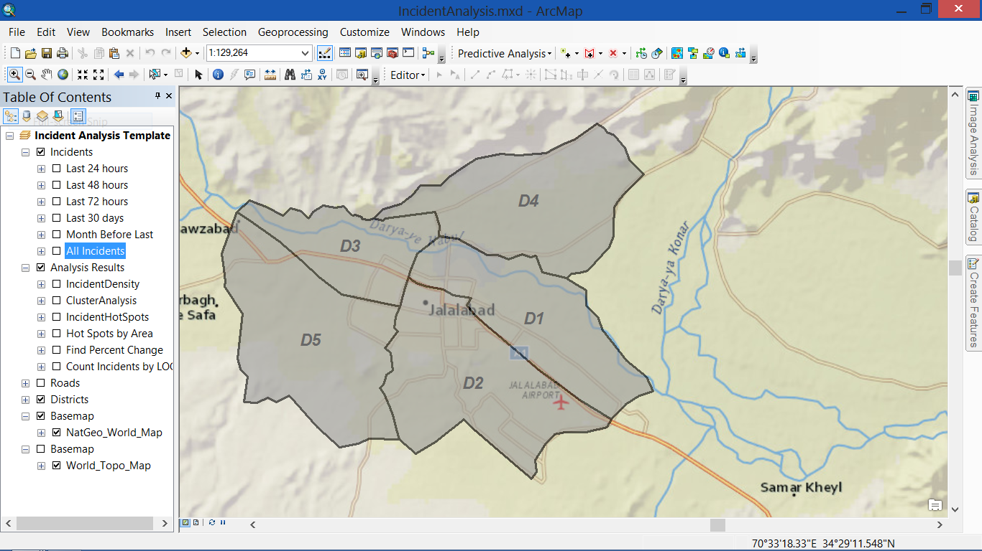
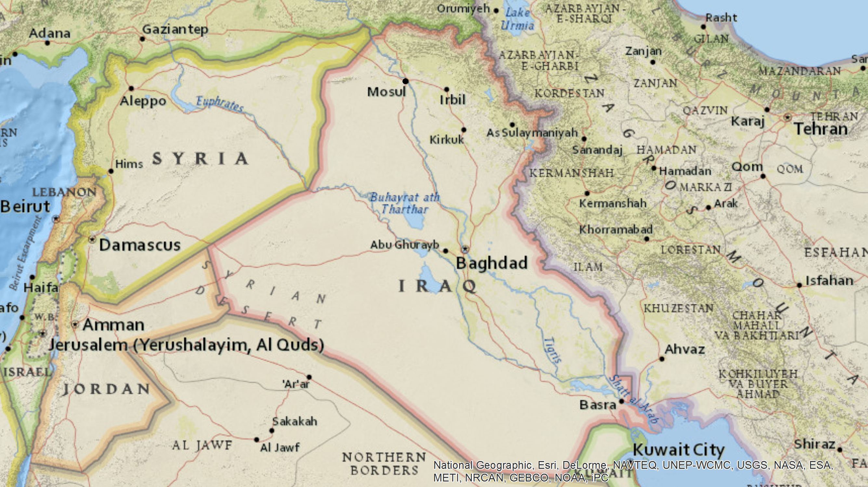
Templates
Maps
Tools
Services
Applications Configuration
Notes:
So what are templates ladies and gents?
Templates are………
What do we use them for?
To jump start our thinking
We do that through this amazing concept called templates. So what are they? They are .mxd’s that contain maps, tools, services and application configurations that allow us to capture tradecraft and share best practices and lessons learned. They are simple, application configurations that model individual workflows. They allow us to be more efficient in how we use our time, to be more effective because we can learn from each other, and they continue to evolve, just like us.

Slide 29
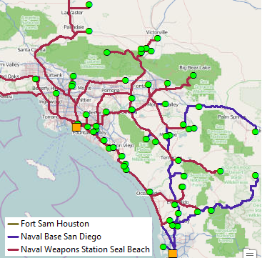
Example: Distance to Asset Template
Project:
How far is it from a military service member’s
home residence to his duty station?
Data:
30,000 Personnel address records in spreadsheet
300 + Base address records
?
Challenges:
Geocoding of addresses
Modelbuilder and Geoprocessing Models
Networks
http://blogs.esri.com/esri/arcgis/2014/10/28/find-the-distance-to-assets-from-bases/
Notes:
This was an example for a customer that I had the experience in working with… She had a project where she needed to match over 30,000 service member’s home addresses to the base that they were stationed. She was having issues with geocoding all those results and then trying to match each person to their base --- over and over again…. It was taking her months to complete the project…..

Slide 30
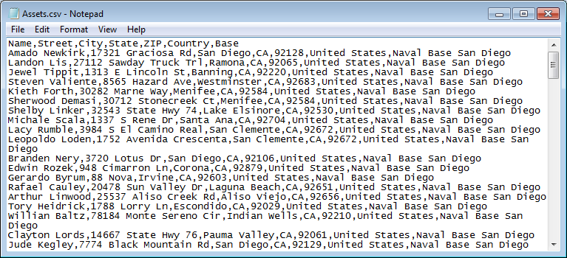
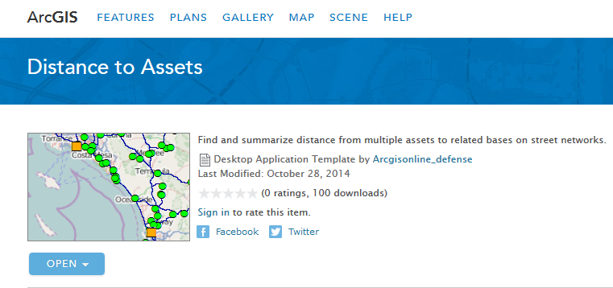
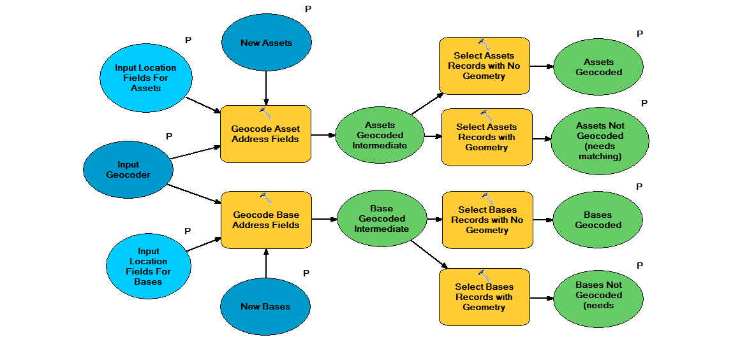
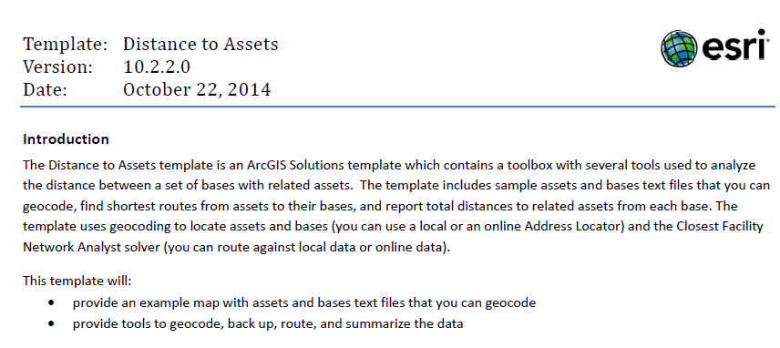
Example: Distance to Asset Template
Data
Maps
Tools
Documentation
Notes:
So I worked with her, gathered some data, created a few maps and developed a few models that helped to automate her work – and most importantly we provided documentation on how to input the data so she could learn bits of the platform that she was unfamiliar with… Since her problem seemed pretty common among the community we released the workflows as a template on ArcGIS online and on our solution pages.
She started using the template, got it configured to point to her data, and what was taking her months to complete, now was just taking her less than a day. Pretty AMAZING.

Slide 31
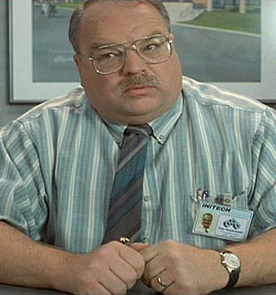
What is a “Solution Engineer?”
Technical Marketing
Professional Services
In between sales and development
Liaise between Redlands and Customers
“ Well-well look. I already told you: I deal with the customers so the engineers don't have to. I have people skills; I am good at dealing with people. Can't you understand that? What the hell is wrong with you people?” -
Tom Smykowski, Office Space
Source: http://www.toptentopten.com/topten/office+space+quotes, Office Space (1999) Dir. M Judge, Perf. Richard Riehle, Twentieth Century Fox, 1999.
Notes:
So who are creating these templates so customers like you can use these to advance your work??? Esri has a Solution division that is made up of Solution Engineers. When I tell people what my position is --- as a sort of go between sales (which gets me facing the customers) and sales, they say--- “Is’nt that like that guy from Office Space.” Well not exactly, true… We may be customer facing engineers, but are main focus is…..

Slide 32
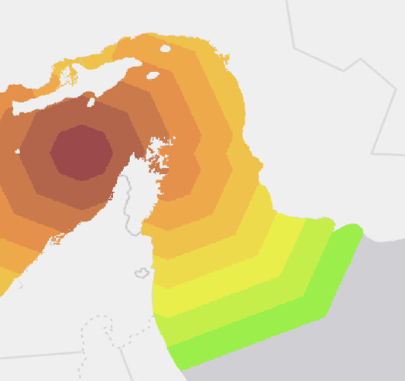
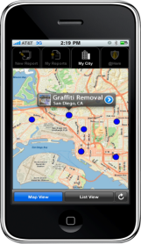
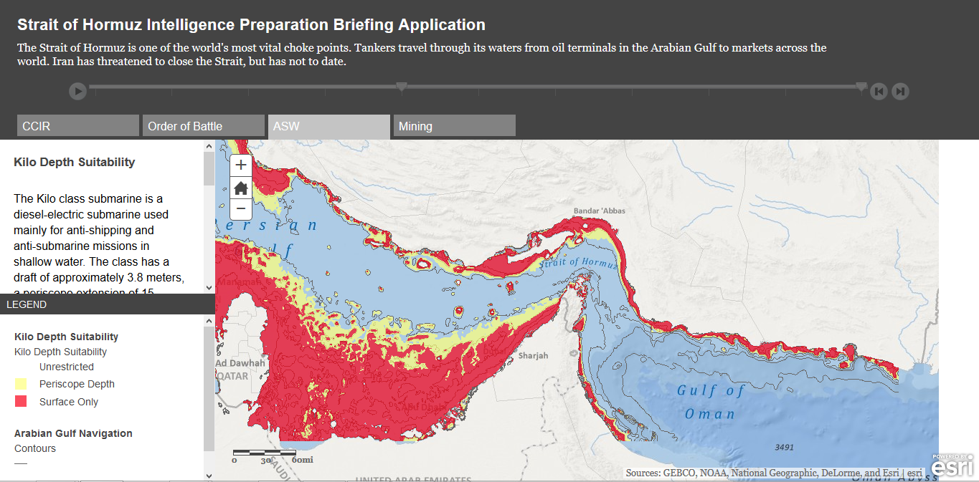
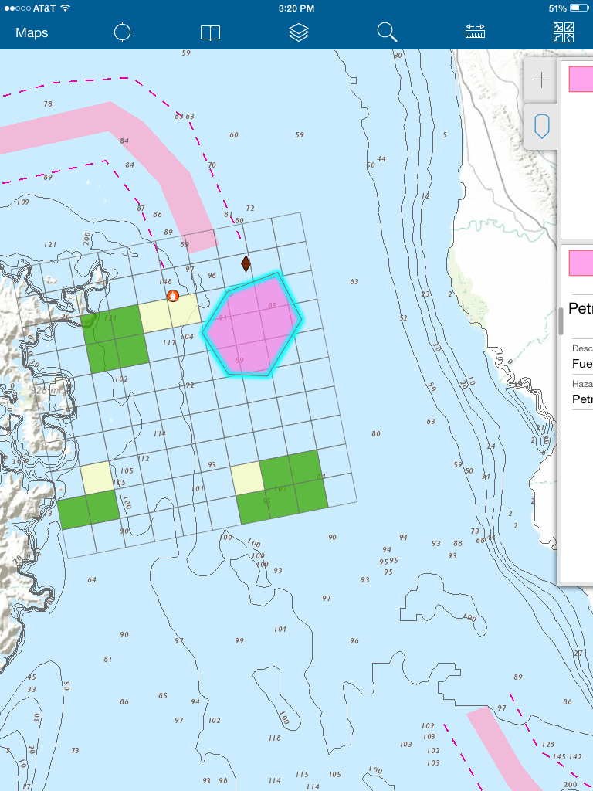
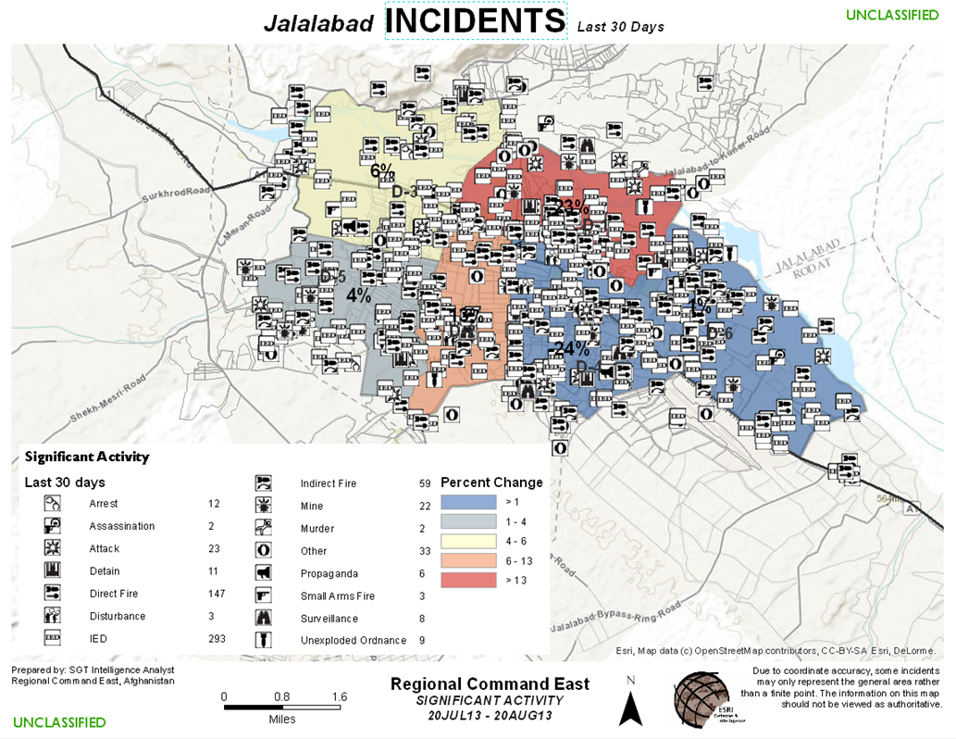
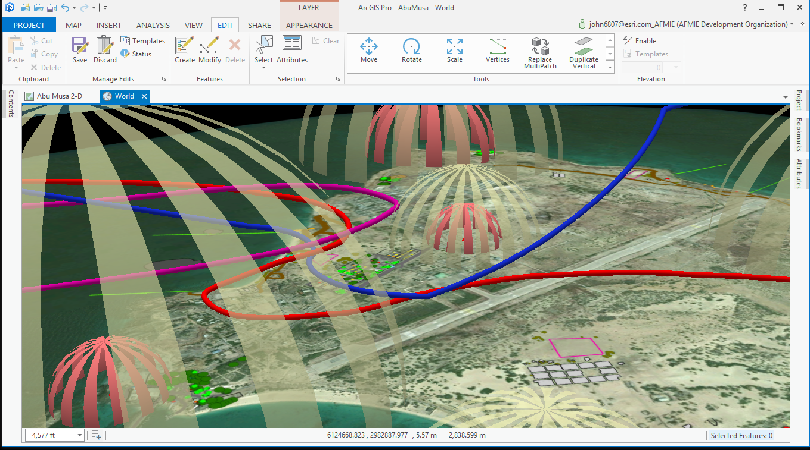
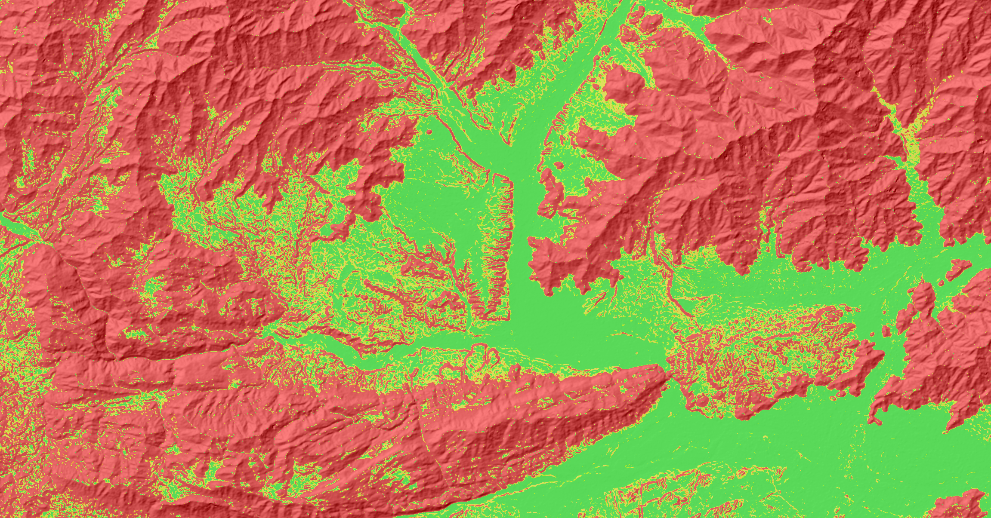
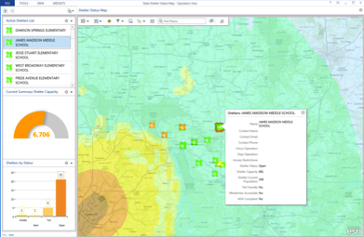
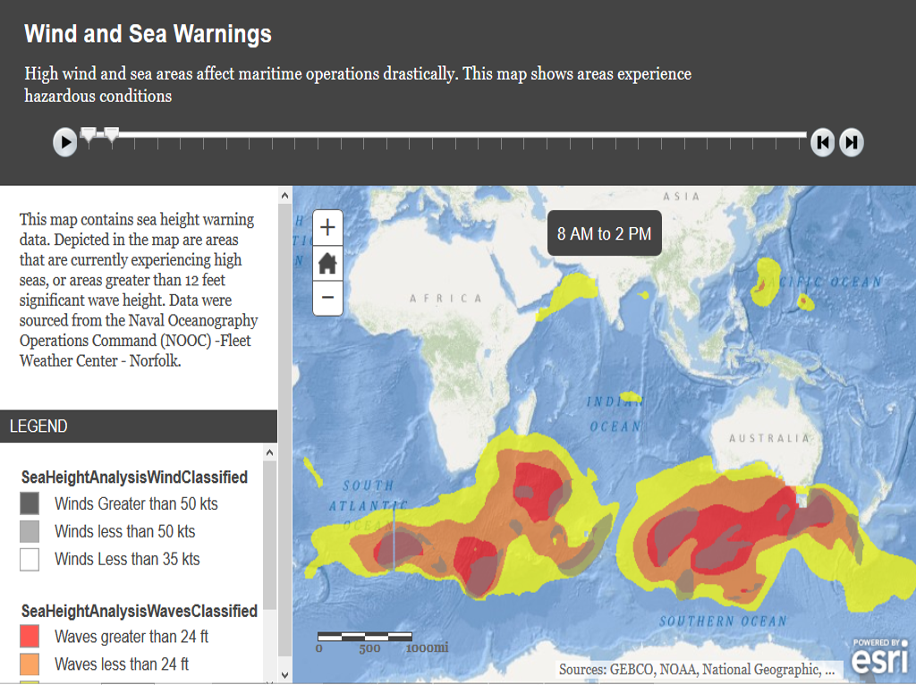
Help People Make a Difference with Maps
Notes:
Helping people make a difference with maps… and we do this by providing free templates for our users to use…. That’s what we do – we find out how to help users be more efficient in using our technology, and provide them with tools to advance their workflows….

Slide 33
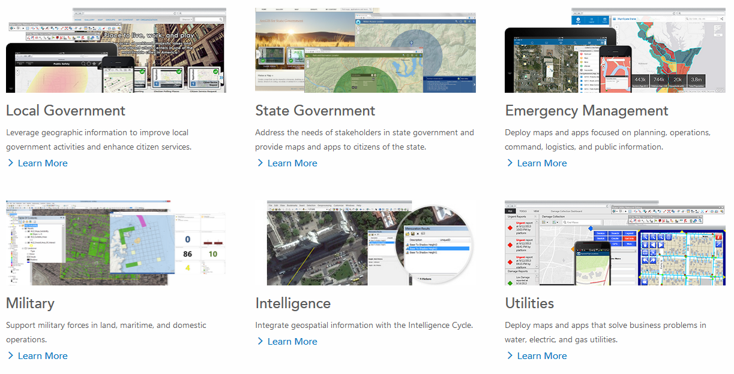
ArcGIS Solutions Pages – solutions.arcgis.com
Notes:
When you arrive at the page – it’s broken down by different industries and you can browse to see what types of templates suit your workflows.

Slide 34
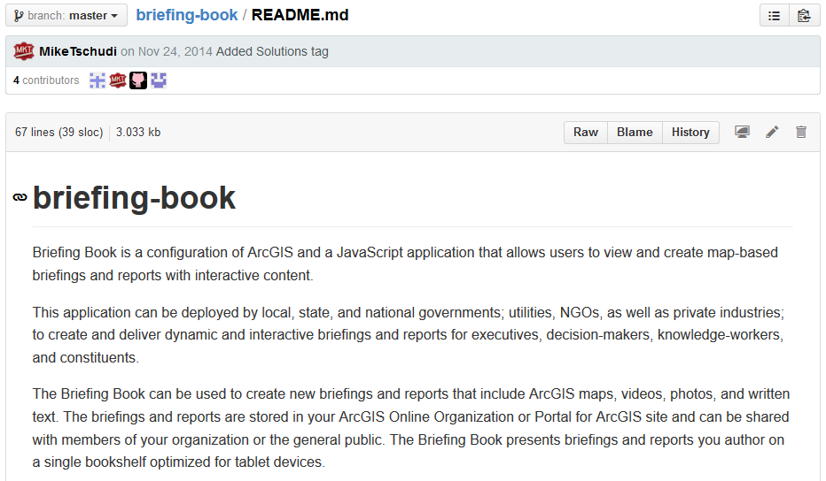
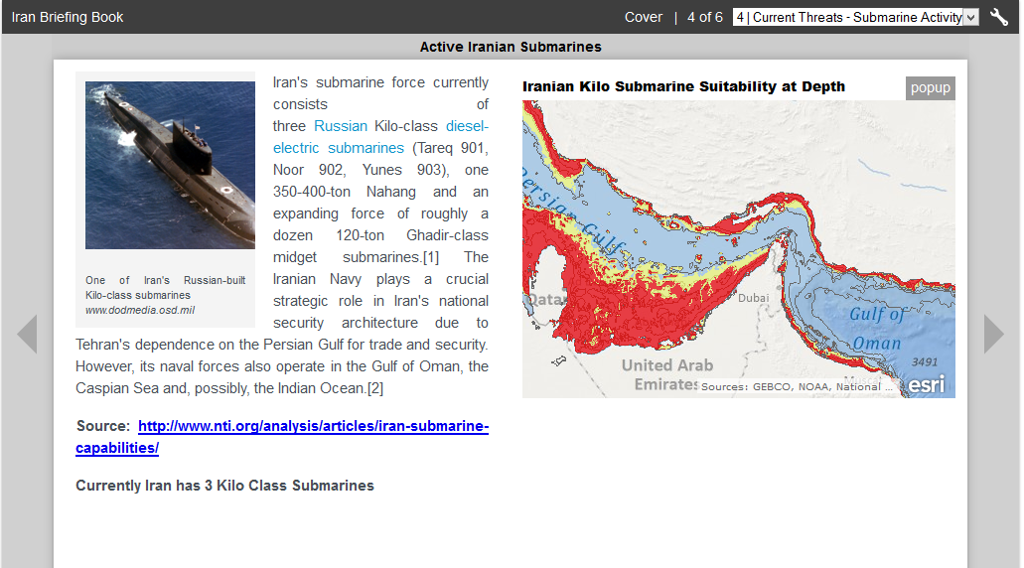
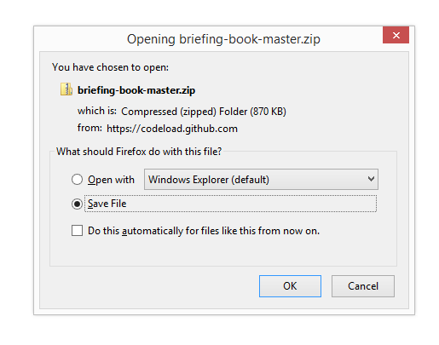
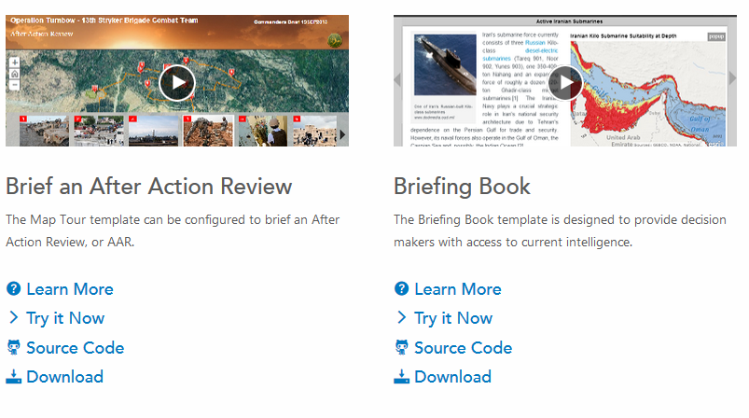
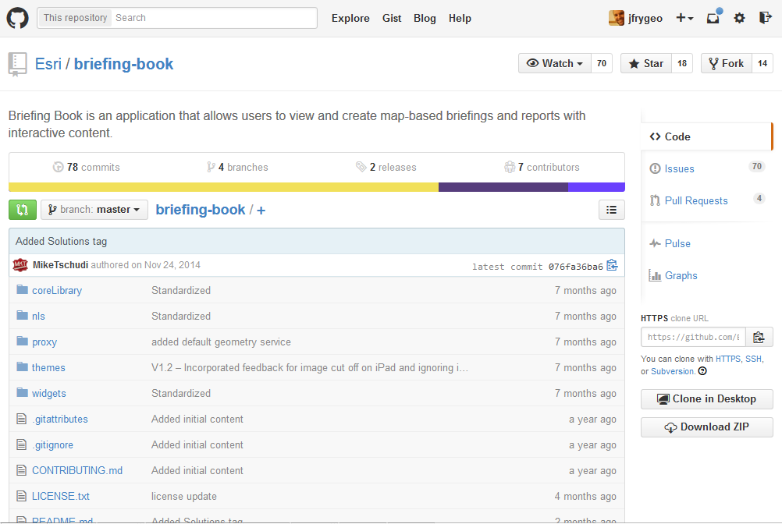
Solution Pages/GitHub – Outlet to Share
Notes:
Here’s for example – you get to learn more about the template, try a live example so you can see what a configured result looks like, view the source code from github if it makes sense, and download a zip file with template contents. Everything you need to get you on your way is on the solution page.

Slide 35

Benefits of Templates
Get your work finished quicker
Learn best practices
Learn use of new technology
Become a GIS hero for your organization
Notes:
So just to recap here: Templates are a great way to help you get your work done quicker, help you learn best practices in a field, and get exposure to new pieces of the ArcGIS Platform….
And they may even help you become a GIS hero in your organization…

Slide 37
Extra Slides

Slide 38
Courtney Claessens
Product Engineer/Community Development for ArcGIS Open Data

Slide 39
product development
- customer needs
- platform needs
- competitive needs
- engineer capabilities

Slide 40
agile team
epics
stories
tasks
testing

Slide 41
product engineer
designer
software engineer
QA engineer

Slide 42
did we do it right?
verification
validation
let them know!

Slide 43




community!
geodc
maptime
1776
opengov hub
young professionals group

Slide 44
John Dombzalski
Account Manager for the Federal Government

Slide 45
Sarah Schwoppe
Solutions Engineer, DC Tech Support

Slide 46

let’s talk

